Slide 1
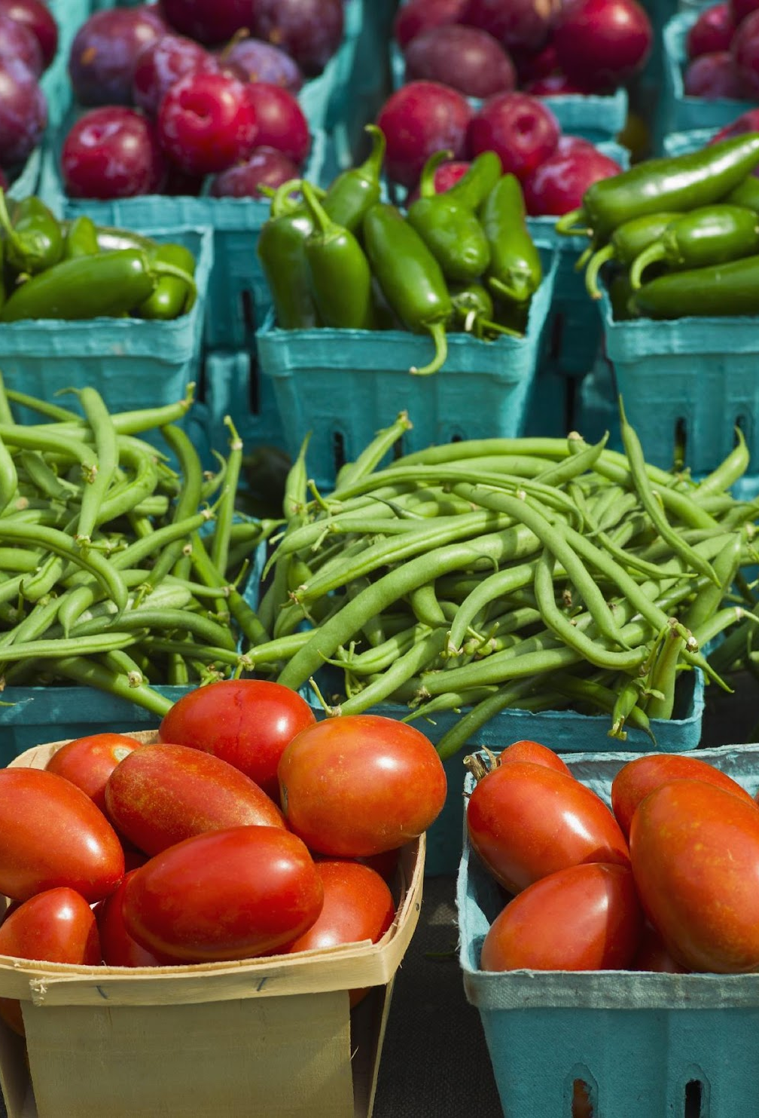
Housing Prices & Food Access
Yahel, Mahire, Ryan, Aidan, and Liya
June 2022

Slide 2
Background
What is a food desert?
“geo­graph­ic areas where res­i­dents have few to no con­ve­nient options for secur­ing afford­able and healthy foods — espe­cial­ly fresh fruits and veg­eta­bles.
What is the connection between housing prices and food access?
10%of census tracts in the United States are food deserts
Notes:
Formative research has found that homes with homes with a Trader joe’s near by had a higher value

Slide 3

Agenda
Objective & Questions
Methods and Materials
Results
Conclusions & Limitations
Recommendations
Sources

Slide 4

How did we get here?
Immigration on Housing Prices and Houselessness
Housing Prices on Houselessness in California
Impact of Organic Food vs Fast Food business on Housing Prices in California
Understanding Relationship between Low food access areas and Housing Prices
Wanted to understand how the immigration and migration impacted housing
Wanted to know if housing prices impacted houselessness over the last 20 years
Areas of with whole foods and trader joes vs areas with only fast food locations impact housing market
Decided to study census data collected on low food access and housing prices using publically available data

Slide 5
Our Research Questions
Does access to food sources impact housing prices in California?
Compared 2015 and 2019
Which zip codes have the most organic grocery stores vs. fast food locations?
How does our research inform our audience’s decision making?

Slide 6




Methods & Materials
Data Acquisition and Cleaning
Google Searches/API
Web Scraping
Jupyter Notebook/Pandas
Data Management
SQL/SQLite
Machine Learning
Supervised Learning
Data Visualization
Tableau
HTML
Notes:
This is a high level overview for the Methods and Materials used for this project
To obtain and clean the data available, we used google searches, google API and web scraping in order to extract food locations and coordinates
For our data management and database we used SQL and SQLite
After running various machine learning models, we determined the Random Forest had the best output. We will go more into detail as to the supervised learning models that were used later in this presentation
We will be presenting our data visualization using tableau as well as a website that was created using html

Slide 7


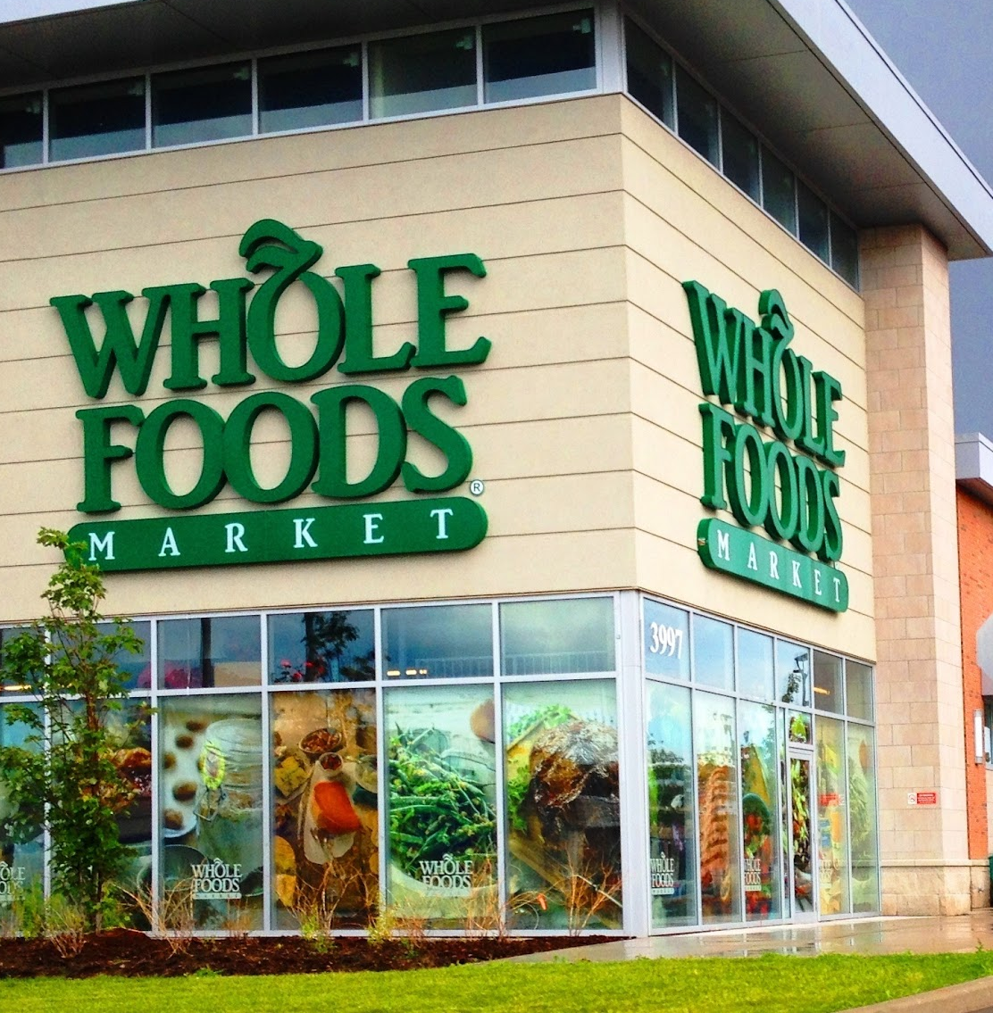
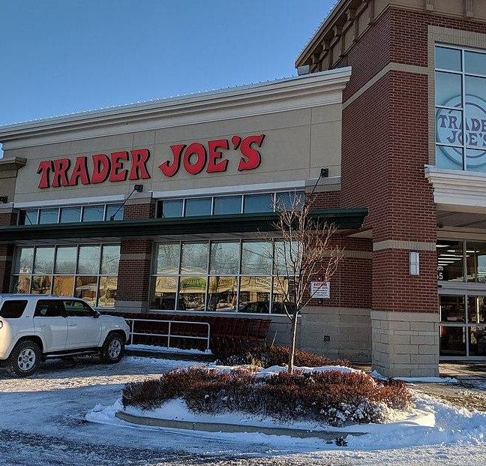

What kind of data did we use?
Data | Used For | Origin
Low Food Access | Machine Learning | US Census
Housing Prices | Machine Learning | Zillow/ US Census
Whole Foods Locations | Data Visualizations | Google API
Trader Joe’s Locations | Data Visualizations | Google/Geopy
Burger King & McDonald’s Locations | Data Visualizations | Google API
Notes:
Low food access
housing prices
whole foods locations
trader joe's locations
Fast food locations

Slide 8
Choosing a Machine Learning Model
Tried several machine learning models
Linear Regression
Polynomial Regression
Decision Tree
Random Forest
Neural Networking Model

Slide 9

Results
This is what we learned..

Slide 10
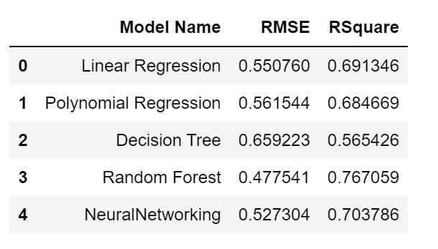
Machine Model Results 2015
Simple Regression Methods
Polynomial Regression
Decision Tree Model
Random Forest Model
Neural Networking Model
Notes:
Food Access data was from 2015
First step cleaning
remove all shared data and kid/seniors
Second step cleaning
linear regression models using all features to predict the housing price (normalized , Z score)
chose 34 parameters among 87
Preprocessing for ML
continuous variables transformed using StandardScaler
categorical variables as dummy coded

Slide 11
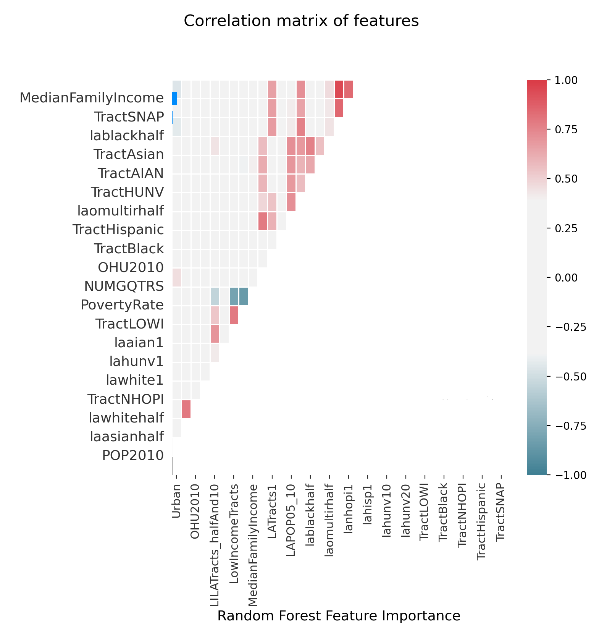

Slide 12
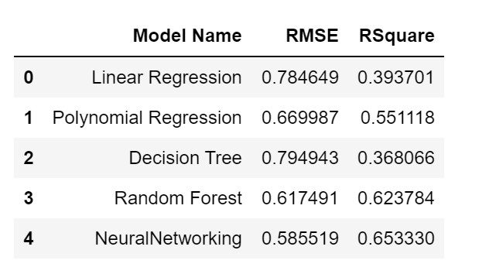
Machine Model Results 2019
Simple Regression Methods
Polynomial Regression
Decision Tree Model
Random Forest Model
NeuralNetworking Model

Slide 13
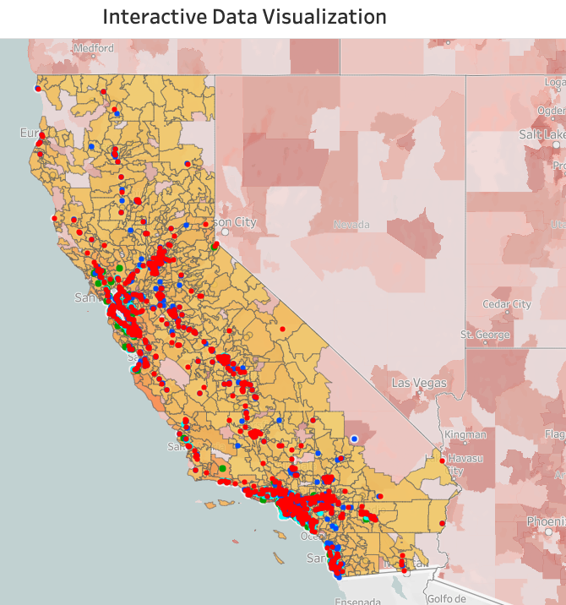
Data Visualization
Organic grocery stores:
Zip Codes with more Organic grocery stores: 94103, 91105, 90046, 90036
3 of these zip codes are in LA county and one in SF county.
The median house value for these zip codes is $1.72M
Zip codes with more fast food locations
There are 66 zip codes with 2 fast food locations.
The median house value for these zip codes is $850K
The median house value next to more organic grocery stores is double than the house value next to location with more fast food.
Housing Prices and Food Access website
Notes:
Yahel
https://public.tableau.com/app/profile/yahel.epel/viz/Final_project_1test/FinalProject

Slide 14

Conclusion & Limitations
77% of food access accessibility explains housing prices in California in 2015
65% for 2019 (Neural Networking)
Limitations
Cannot establish a strong relationship
Outdated data
Analysis does not include other confounding factors
Ex: Date of opening of Whole Foods and Trader Joe’s

Slide 15
Recommendations/ Key Lessons Learned
Food accessibility thought to be focused on distance, but it actually encompasses a combination of variables.
Future analyses should review:
Housing price changes over time. Include data from multiple years.
Other demographic data like median household income, poverty rate, school district, race and ethnicity, location of corporate business
Interest rate
Migration data
Have more complete datasets that can be merged to provide a comprehensive understanding

Slide 16
Sources
This is how grocery chains affect a home’s value
Does the New Whole Foods in Your Neighborhood Increase Your Home Value?
USDA Food Access Data
Notes:
Ryan

